Slide 1



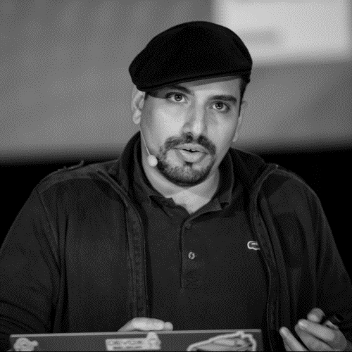
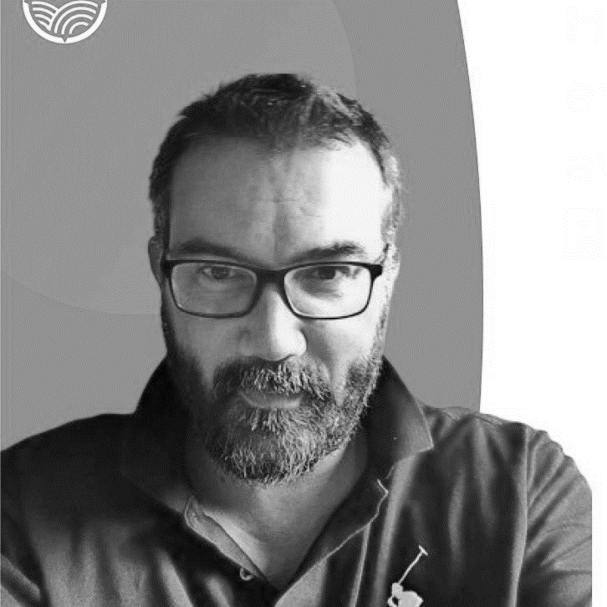


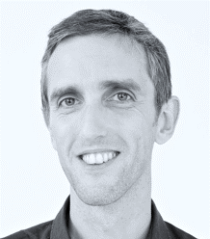
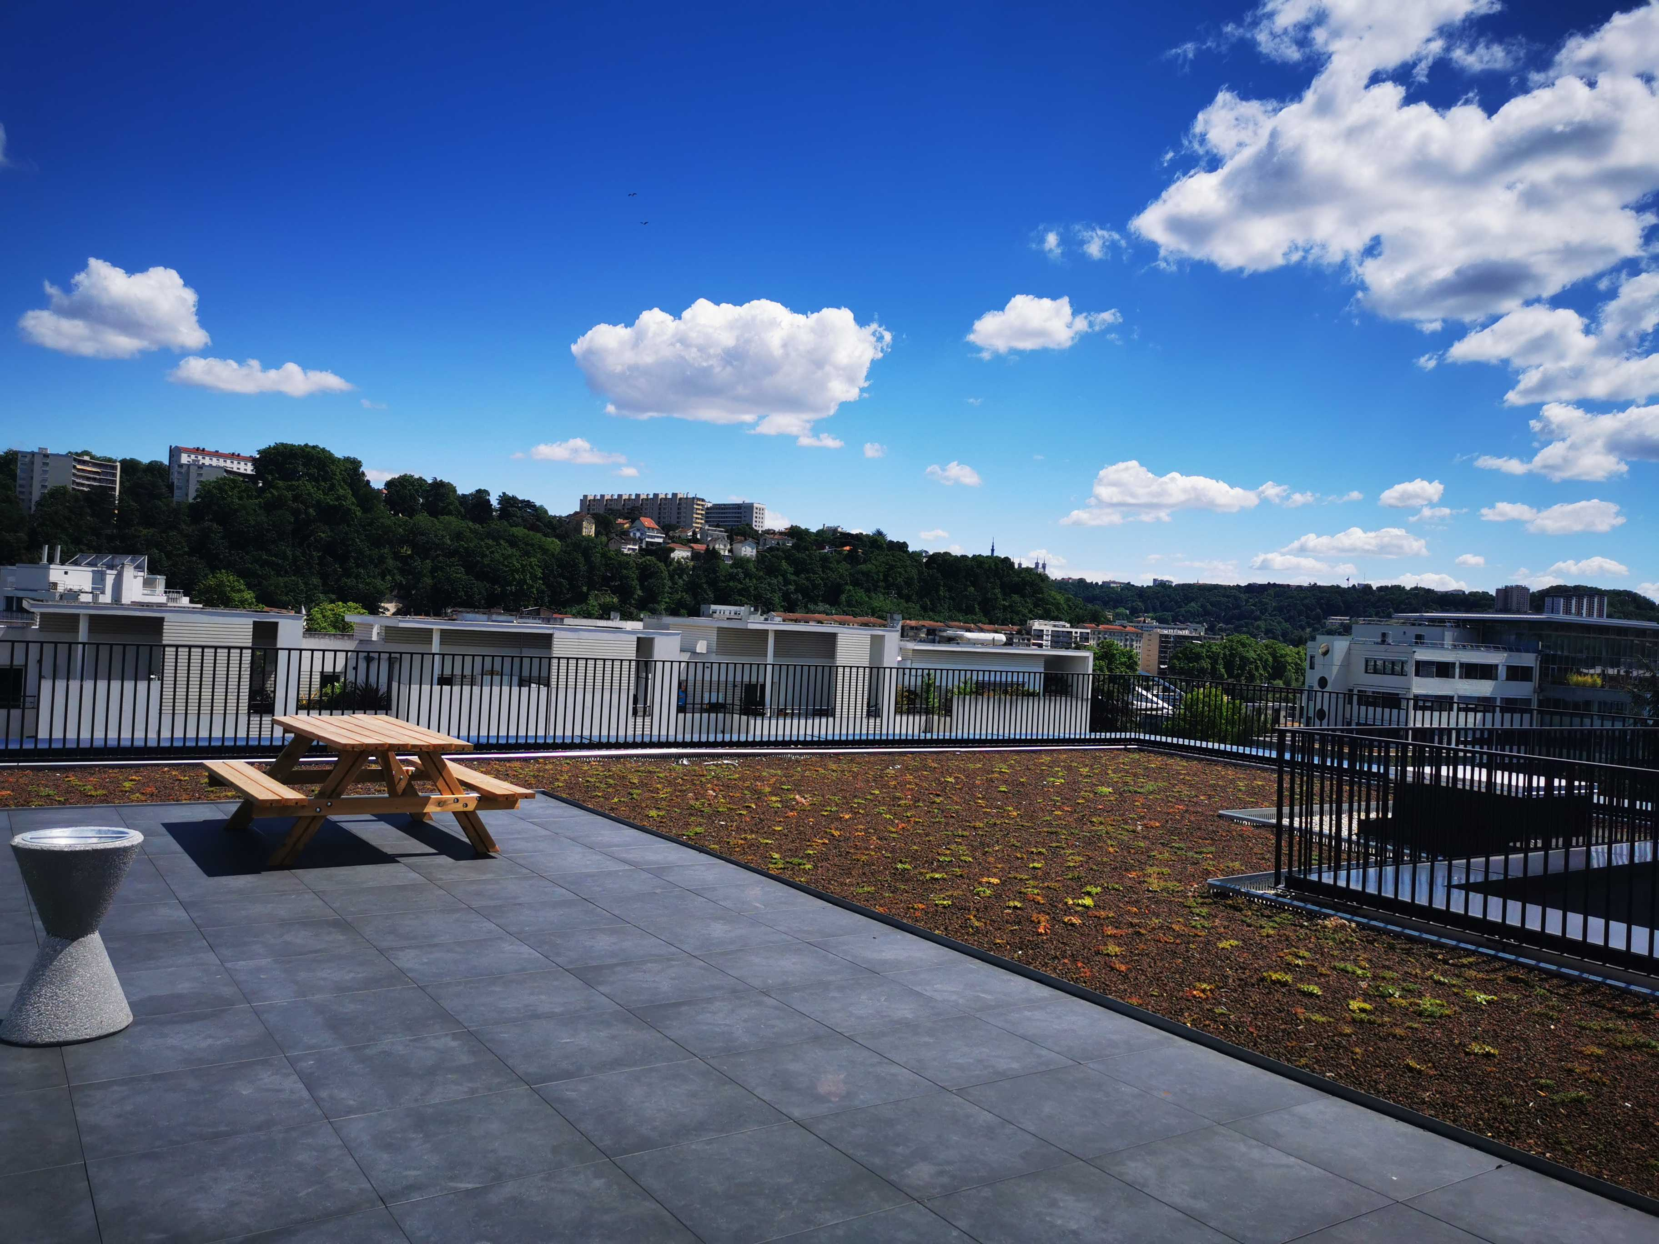
Show me your domain!
Tuesday Sept 13th 2022
19h00
IRL at
#DDDFR
( Lyon )
Julien Topçu (shodo)
Train booking
Caroline Desplanques
Thomas PIERRAIN (agicap)
Cashflow monitoring
3 domains presented in 20’ with Context Maps on a building rooftop
Maguy Ribeiro (Michelin) Jeremie Grodziski (Defsquare )
tire industry

Slide 2
Context maps on the roof
Tuesday Sept 13th 2022
19h00
IRL at
#DDDFR
( Lyon )
Julien Topçu (shodo)
Train booking
Caroline Desplanques
Thomas PIERRAIN (agicap)
Cashflow monitoring
3 domains presented in 20’ with Context Maps on a building rooftop
Maguy Ribeiro (Michelin) Jeremie Grodziski (Defsquare )
tire industry

Slide 3
Context maps on the roof
Tuesday Sept 13th 2022
19h00
IRL at
#DDDFR
( Lyon )
Cash flow monitoring
3 domains presented in 20’ with Context Maps on a building rooftop
Caroline Desplanques
Thomas PIERRAIN (agicap)

